Slide 1
Web Technologies II
BIM 4th Semester

Slide 2
Books
Robin Nixaon - Learning PHP, MySQL & JavaScript: A Step-by-Step Guide to Creating Dynamic Websites
Jon Duckett - PHP & MySQL: Server-side Web Development

Slide 3
Web Technologies
Technologies used for developing and accessing content on the World Wide Web.
It could refer to HTML, CSS, and JavaScript, as well as server-side technologies like PHP, Python, or Node.js.
Additionally, it might include frameworks and libraries such as React, Angular, or Vue.js, along with database systems like MySQL, MongoDB, or PostgreSQL.
Overall, tools and techniques used in web development.

Slide 4
Server-side scripting
Server-side scripting refers to the programming that is executed on the server rather than on the client's device.
This type of scripting is used to create dynamic web pages, manage sessions, interact with databases, and perform other operations that require processing power and security that a server provides.

Slide 5
Key Aspects of Server-Side Scripting:
Execution on the Server:
The script runs on the server where the website is hosted.
The server processes the script and sends the generated HTML to the client's browser.
Interactivity and Dynamic Content:
Allows the creation of dynamic web pages that change based on user interactions or other conditions.
Can serve different content to different users based on their inputs or profiles.

Slide 6
Key Aspects of Server-Side Scripting:
Database Interaction:
Server-side scripts can query databases, retrieve data, and incorporate it into web pages.
Commonly used for user authentication, data storage, and retrieval.
Security:
Since the script runs on the server, sensitive operations like authentication and database access are more secure.
The server can control access to certain resources and perform checks before serving content.

Slide 7
Key Aspects of Server-Side Scripting:
Session Management:
Allows maintaining state and session information across multiple requests from the same user.
Useful for managing user logins, shopping carts, and personalized experiences.

Slide 8
Common Server-Side Scripting Languages:
PHP
Node.js:
Python
Ruby
Java
ASP.NET

Slide 9
PHP
PHP is a server-side scripting language , and a powerful tool for making dynamic and interactive Web pages.
It allows developers to create dynamic content for websites and web applications.
PHP is often embedded within HTML, making it easy to integrate into web pages.
The file extension of PHP is “.php”.

Slide 10
PHP
PHP is an acronym for "PHP: Hypertext Preprocessor"
PHP is a widely-used, open source scripting language
PHP scripts are executed on the server
PHP is free to download and use

Slide 11
Characteristics of PHP
PHP code is executed in the server.
It can be integrated with many databases such as Oracle, Microsoft SQL Server, MySQL, PostgreSQL, Sybase, and Informix.
It is powerful to hold a content management system like WordPress and can be used to control user access.
It supports main protocols like HTTP Basic, HTTP Digest, IMAP, FTP, and others.
PHP can be easily embedded in HTML files and HTML codes can also be written in a PHP file.
PHP codes are first executed on the server and then the result is returned to the browser.
PHP files can support other client-side scripting languages like CSS and JavaScript.

Slide 12
Hello World Using PHP
<!DOCTYPE html>
<html>
<body>
<?php
echo "Hello, World!!";
?>
</body>
</html>

Slide 13
Advantages of PHP
Open Source:
Freely available for use and distribution. This encourages a large community of developers, contributing to its growth and improvement.
Easy to Learn:
PHP syntax is similar to C and other programming languages, making it relatively easy for developers to learn, especially for those with a background in programming.
Web Integration:
PHP is designed specifically for web development and is embedded within HTML.
Database Support:
PHP has excellent support for various databases, including MySQL, PostgreSQL, SQLite, and more.

Slide 14
Advantages of PHP
Cross-Platform Compatibility:
PHP is platform-independent and runs on various operating systems, including Windows, Linux, macOS, and others.
Large Community and Documentation:
PHP has a vast and active community of developers. The abundance of online resources, tutorials, and documentation makes it easier for developers to find solutions and seek help when needed.
Frameworks and CMS:
There are popular PHP frameworks like Laravel, Symfony, and CodeIgniter, which provide pre-built modules and features, aiding in rapid development.
Additionally, PHP supports widely used content management systems (CMS) like WordPress and Joomla.

Slide 15
Disadvantages of PHP
Inconsistency:
PHP has been criticized for inconsistencies in function names and parameter orders.
This can lead to confusion for developers, especially when working with a mix of older and newer functions.
Security Concerns:
If not handled properly, PHP code may be susceptible to security vulnerabilities, such as SQL injection and cross-site scripting (XSS).
Performance:
While PHP performs well for many web applications, it may not be as fast as some compiled languages like C or Java.
However, advancements and optimizations in recent versions have improved performance.
Notes:
SQL injection is a code injection technique used to exploit vulnerabilities in a web application's software by injecting malicious SQL statements into an entry field for execution.
This can allow attackers to access, manipulate, or delete data in a database, and can potentially compromise the entire database server.

Slide 16
Disadvantages of PHP
Lack of Modern Features:
Compared to newer languages, PHP may lack some modern language features.
However, recent versions of PHP have introduced improvements and features to address this concern.
Scalability Challenges:
PHP can face challenges when it comes to scaling large and complex applications.
Developers may need to adopt additional tools or frameworks to address scalability issues.
Not Suitable for Large-Scale Applications:
While PHP is suitable for small to medium-sized projects, it might not be the best choice for extremely large and complex applications where more structured languages might be preferred.

Slide 17
Prerequisites
PHP Environment:
Make sure PHP is installed on your local machine or web server.
Tools like XAMPP, WAMP, or MAMP can help set up a local PHP development environment.
Text Editor or IDE:
Use a text editor or integrated development environment (IDE) to write PHP code.
Common options include Visual Studio Code, Sublime Text, or PhpStorm.
Web Server:
To execute PHP code, you need a web server like Apache or Nginx.

Slide 18
Set Up PHP on Your Own PC
In order to develop and run PHP Web pages, you need to install three vital components on your computer system.
install a web server, such as Apache
install PHP
install a database, such as MySQL
NOTE: The official PHP website (PHP.net) has installation instructions for PHP: http://php.net/manual/en/install.php

Slide 19
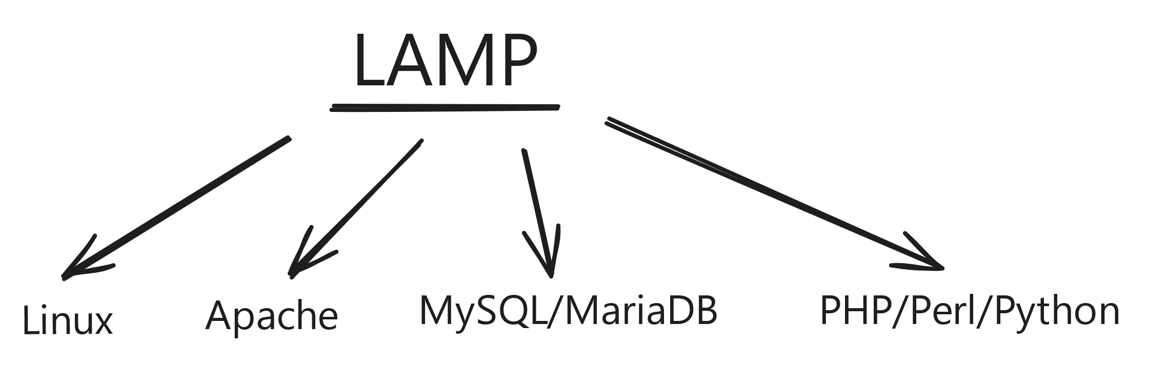
Set Up PHP on Your Own PC
PHP is often used with LAMP stack.

Slide 20
PHP Installer Tools on Windows
XAMPP
XAMPP is a popular software package designed to make it easier to set up a local development environment for web applications.
The acronym XAMPP stands for:
X (cross-platform): Indicates that XAMPP is cross-platform, available for Windows, macOS, and Linux.
Apache: The Apache web server, used to host web content and handle HTTP requests.
MySQL/MariaDB: The database management system for storing and managing data. Initially, MySQL was used, but many distributions now include MariaDB, an open-source fork of MySQL.
PHP: The scripting language used for server-side development.
Perl: Another scripting language included in XAMPP, though less commonly used in web development than PHP.

Slide 21
PHP Installer Tools on Windows
To install and use XAMPP, follow these general steps:
Download XAMPP: Visit the official XAMPP website and download the appropriate version for your operating system.
Install XAMPP: Follow the installation instructions for your platform. Choose which components to install, and select the desired installation path.
Start the Control Panel: After installation, open the XAMPP control panel to start and stop individual components. You can also access additional configuration settings from this interface.
Begin Development: Once Apache and MySQL/MariaDB are running, you can start developing web applications, interacting with databases, and testing your code. Access the default XAMPP landing page to explore available tools like phpMyAdmin and others.

Slide 22
PHP MyAdmin
TphpMyAdmin is a popular open-source tool used for managing MySQL and MariaDB databases via a web-based interface.
It's a common utility for developers and database administrators, providing a simple and intuitive way to interact with databases without having to use command-line tools.

Slide 23
Features
PhpMyAdmin offers a comprehensive set of features for managing MySQL/MariaDB databases:
Database Management: Create, drop, and modify databases. You can also view and alter database properties like collation and charset.
Table Operations: Create, modify, and delete tables. This includes changing table structure, adding/removing indexes, and managing table constraints.
Data Manipulation: Insert, update, and delete records in database tables. You can also import and export data in various formats (e.g., CSV, SQL).

Slide 24
Features
PhpMyAdmin offers a comprehensive set of features for managing MySQL/MariaDB databases:
SQL Query Execution: Write and execute custom SQL queries. phpMyAdmin provides a query editor with syntax highlighting, making it easier to write complex queries.
User Management: Manage database users and their permissions. This includes creating new users, granting/revoking privileges, and managing user-specific settings.
Backup and Restore: Perform database backups and restores. phpMyAdmin allows you to export databases in SQL format, which can be used for backup or migration purposes.

Slide 25
Common Tasks
phpMyAdmin is commonly used for a variety of database-related tasks:
Creating a New Database: Use the "Databases" tab to create a new database. You can set the database name, collation, and other properties.
Adding a Table: After selecting a database, use the "Structure" tab to create a new table. Define the table's columns, data types, and constraints.
Inserting Data: Use the "Insert" tab to add records to a table. You can insert multiple rows at once and specify default values for certain fields.

Slide 26
Common Tasks
phpMyAdmin is commonly used for a variety of database-related tasks:
Executing SQL Queries: Use the "SQL" tab to execute custom SQL queries. This can be useful for complex operations or bulk data manipulation.
Managing Users and Permissions: Use the "User accounts" tab to manage database users. You can set user permissions, assign roles, and control access levels.
Importing/Exporting Data: The "Import" and "Export" tabs allow you to import data into a database and export data for backup or migration. phpMyAdmin supports various formats, including SQL, CSV, and Excel.

Slide 27
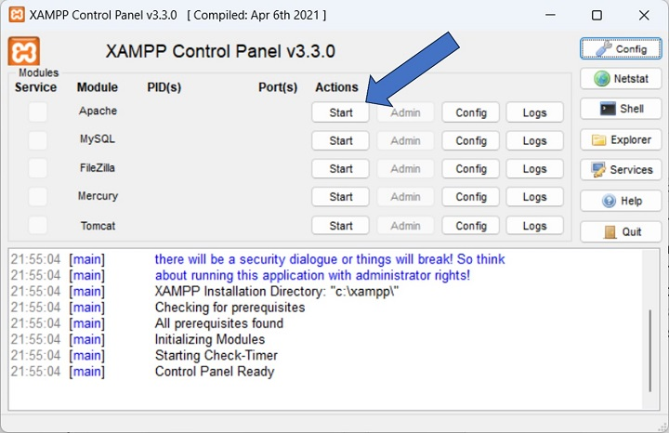
While on a Windows operating system, start the Apache server from the XAMPP control panel.

Slide 28
Default root directories:
WAMP Server - C:\wamp\www\
XAMPP Server - C:\xampp\htdocs\
Linux OS - /var/www/
Mac OS - /htdocs/

Slide 29
Common errors in XAMPP and their solutions:
Apache Not Starting:
Port Conflict: Apache might not start if port 80 or 443 is already in use by another application.
Solution: Change the port numbers in the httpd.conf and httpd-ssl.conf files. For example, change Listen 80 to Listen 8080 and Listen 443 to Listen 4443.
Alternatively, stop the service occupying the port (like Skype or IIS).

Slide 30
Common errors in XAMPP and their solutions:
MySQL Not Starting:
Port Conflict: MySQL might not start if port 3306 is occupied.
Solution: Change the port in the my.ini file (under [client] and [mysqld] sections) to a different number, like 3307.
Database Corruption: MySQL might not start if port 3306 is occupied.
Solution: Check the mysql_error.log for details. You might need to repair corrupted databases using tools like mysqlcheck or innodb_force_recovery.

Slide 31
Writing Simple PHP Program
<!DOCTYPE html>
<html>
<body>
<?php
echo “Welcome BIM 4th Semeter.";
?>
</body>
</html>

Slide 32
PHP - Syntax
A ".php" file may contain HTML, CSS and JavaScript code blocks along with the PHP code.
Hence, the PHP parser must differentiate between the PHP code from the other elements.
When a ".php" file is opened in the web browser, the HTML engine renders the HTML/CSS/JavaScript part and escapes out of the HTML block as soon as the statements included in PHP tags are encountered.
The PHP parser interpreter processes this block and returns the response to the browser.

Slide 33
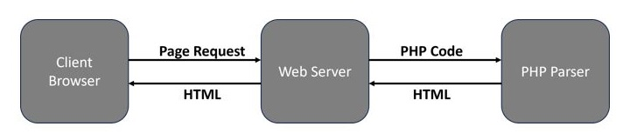
PHP - Syntax

Slide 34
PHP - Syntax
PHP defines two methods of using tags for escaping the PHP code from HTML.
Canonical PHP tags and
Short-open (SGML-style) tags.

Slide 35
Canonical PHP Tags
The most universally effective PHP tag style is −
<?php
One or more PHP statements
?>
If you use this style, you can be positive that your tags will always be correctly interpreted.

Slide 36
2. Short-open (SGML-style) Tags
Short or short-open tags look like this −
<?php
One or more PHP statements
?>
Short tags are, as one might expect, the shortest option. You must do one of two things to enable PHP to recognize the tags −
Choose the "--enable-short-tags" configuration option when you're building PHP.
Set the "short_open_tag" setting in your php.ini file to on.
short_open_tag=on
This option must be disabled to parse XML with PHP because the same syntax is used for XML tags.

Slide 37
Others tags
Asp style tags :
This tag is not so common but is used sometimes.
<% ... %>
HTML script tags: This method is used mostly when we need to write php code inside html
<script language="php">.....</script>

Slide 38
PHP considerations
PHP is white space insensitive (It does not matter how many whitespace characters you have in a row or column)
e.g $four= 2 +2 =>4 //white space lines does not matter
Statements are terminated by semicolon (;)
e.g $stat=''we are learning php" ;

Slide 39
PHP considerations
PHP is semi case sensitive : which means some features are case-sensitive while others are not.
Following are case-insensitive
Keywords (if, else, while, for, foreach, etc.)
Inbuilt Functions like print_r() and some other
Statements
Classes name (in PHP class name are case-insensitive on Windows and mac OS while case sensitive in Linux)
User defined functions (only after PHP 8)

Slide 40
PHP considerations
Following are case sensitive
PHP Variables are case-sensitive.
e.g $Name is not same as $name
Inbuilt functions like in_array is case sensitive
Constants

Slide 41
Comments in PHP
A comment in PHP code is a line that is not executed as a part of the program.
Its only purpose is to be read by someone who is looking at the code.

Slide 42
Comments can be used to:
Let others understand your code
Remind yourself of what you did - Most programmers have experienced coming back to their own work a year or two later and having to re-figure out what they did. Comments can remind you of what you were thinking when you wrote the code
Leave out some parts of your code

Slide 43
There are two commenting formats in PHP −
Single-line Comments
Multi-line Comments

Slide 44
Single-line Comments
They are generally used for short explanations or notes relevant to the local code.
PHP uses two notations for inserting a single-line comment in a program.
Single-line Comments Using "#“
<?php
# Single line comment starting with # symbol
echo 'Hello World';
?>

Slide 45
Single-line Comments
Single-line Comments Using "//“
PHP also supports C style of single-line comments with "//" symbol.
<?php
// Single line comment starting with // symbol
echo 'Hello World';
?>
NOTE:
A comment that starts with the symbol "#" or "//" need not be closed.
The effect of these symbols last till the end of the physical line.

Slide 46
Multi-line Comments
Multi-line comments are generally used to provide pseudocode algorithms and more detailed explanations when necessary.
The multiline style of commenting is the same as in C. One or more lines embedded inside the "/*" and "*/" symbols are treated as a comment.

Slide 47
Example of Multi-line Comment in PHP
<?php
/* This is a multiline comment example
program to add two numbers
Variables used - $x for first number,
$y for second number */
$x=10;
$y=20;
print "Total = ". $x+$y;
?>

Slide 48
PHP Parse error:
However, if there is a "/*" symbol in the program, it must have a closing end-of comment marker "*/".
If not, an error will be displayed as follows −
PHP Parse error: Unterminated comment starting line 3 in /home/cg/root/65ded9eeb52fc/main.php on line 3
NOTE: you can put even a single line inside the "/* .. */" symbols.

Slide 49
PHP - Variables
Variables are "containers" for storing information.
A variable can have a short name (like $x and $y) or a more descriptive name ($age, $carname, $total_volume).
When you assign a text value to a variable, put quotes around the value.
<?php
$name = "Tika Ram"; // assign number value to a variable
$age = 27; // assign text value to a variable
echo "Name : $name <br>";
echo "Age : " . $age;
?>

Slide 50
Rules for PHP variables:
A variable starts with the $ sign, followed by the name of the variable
A variable name must start with a letter or the underscore character
A variable name cannot start with a number
A variable name can only contain alpha-numeric characters and underscores (A-z, 0-9, and _ )
Variable names are case-sensitive ($age and $AGE are two different variables)

Slide 51
PHP is a Loosely Typed Language
We do not need to explicitly declare the data types of variables.
PHP handles type conversions automatically, which provides flexibility but can also lead to potential pitfalls if not managed carefully.
<?php
$x = 10; // $x is an integer
$y = "20"; // $y is a string
echo "x + y is: ", $x + $y; // PHP converts $y to an integer and adds it to $x
?>
OUTPUT: x + y is: 30

Slide 52
PHP echo and print Statements
Both echo and print statements are used to render the output either on the browser or the PHP console.
Parentheses should not be used with either of them.
The differences are small:
echo has no return value while print has a return value of 1 so it can be used in expressions.
echo can take multiple parameters (although such usage is rare) while print can take one argument.
echo is marginally faster than print.

Slide 53
The PHP echo Statement
The echo statement can be used with or without parentheses: echo or echo()
The echo statement outputs one or more expressions, with no additional newlines or spaces.
Syntax:
Example:
echo "<h2>PHP is Fun!</h2>";
echo "Hello world!<br>";
echo "I'm about to learn PHP!<br>";
echo "This ", "string ", "was ", "made ", "with multiple parameters."; // multiple parameters
?>
echo(string ...$expressions): void

Slide 54
The PHP print Statement
The print statement can be used with or without parentheses: print or print().
PHP accepts a single argument only and always returns 1.
Syntax:
Example:
<?php
print "<h2>PHP is Fun!</h2>";
print "Hello world!<br>";
print "I'm about to learn PHP!";
?>
print(string $expression): int

Slide 55
PHP Constants
A constant is an identifier (name) for a simple value.
A constant value cannot change during the execution of the PHP script.
A valid constant name starts with a letter or underscore (no $ sign before the constant name).
To create a constant, use the define() function.
Syntax: define(name, value, case-insensitive);
case-insensitive: Specifies whether the constant name should be case-insensitive. Default is false.
Note: Defining case-insensitive constants was deprecated in PHP 7.3.
PHP 8.0 accepts only false, the value true will produce a warning.

Slide 56
PHP Constants
Example:
<?php
// case-sensitive constant name
define("GREETING", "Welcome to BIM 4th Semester!");
echo GREETING;
?>
Output: Welcome to BIM 4th Semester!

Slide 57
Constants VS Variables in PHP
Constants cannot be defined by simple assignment; they can only be defined using the define() function.
Constants may be defined and accessed anywhere without regard to variable scoping rules.
Once the Constants have been set, they may not be redefined or undefined.

Slide 58
PHP const Keyword
You can also create a constant by using the const keyword.
Example:
<?php
const MYCAR = "Volvo";
echo MYCAR;
?>

Slide 59
const vs. define()
const are always case-sensitive
define() has has a case-insensitive option.
const cannot be created inside another block scope, like inside a function or inside an if statement.
define can be created inside another block scope.

Slide 60
PHP Data Types
Classification of data in distinct categories.
PHP has eight data types:
Integers − Whole numbers, without a decimal point, like 4195.
Doubles − Floating-point numbers like 3.14159 or 49.1.
Booleans − Have only two possible values, either true or false.
NULL − Special type that only has one value: NULL.
Strings − Sequences of characters, like 'PHP supports string operations.'
Arrays − Named and indexed collections of other values.

Slide 61
PHP Data Types
There are two ways to declare an array.
An array can be declared using the array() function.
$array = array('Apple', 'Banana', 'Orange', 'Mango’);
An array can be declared wrapping with [ and ].
$array = ['Apple', 'Banana', 'Orange', 'Mango'];

Slide 62
PHP Data Types
Objects − Instances of programmer-defined classes, which can package up both other kinds of values and functions that are specific to the class.
To create a new object, use the new statement to instantiate a class:
<?php
class foo{
function bar() {
echo "Hello World";
}
}
$obj = new foo();
$obj->bar();
?>

Slide 63
PHP Data Types
Resources − Special variables that hold references to resources external to PHP (such as database connections).
Here is an example of file resource:
<?php
$file = fopen("example.txt", "r");
if ($file) {
var_dump($file);
fclose($file);
} else {
echo "Failed to open file.";
}
?>

Slide 64
Type Casting
The term "Type Casting" refers to conversion of one type of data to another.
Since PHP is a weakly typed language, the parser coerces certain data types into others while performing certain operations.
There are two types of casting:
Implicit Casting (Automatic)
Explicit Casting (Manual)

Slide 65
Implicit Casting (Automatic)
Implicit casting is done by PHP automatically.
When dividing an integer by another integer the result can either be integer or float. The decision is taken by PHP.
<?php
$x = 5; // An integer)
$y = 4; // An integer)
$a=$x/$y; // a float value
echo $a; // 1.25
?>

Slide 66
Explicit Casting:
We can explicitly cast a variable to different data types manually.
For instance, we can convert a float to an integer like following.
<?php
$x = 5.35;
$y = (int) $x; // casted $x to integer
var_dump($y) // output 5
?>

Slide 67
Type Casting Operators
(int) or (integer) casts to an integer
(bool) or (boolean) casts to a boolean
(float) or (double) or (real) casts to a float
(string) casts to a string
(array) casts to an array
(object) casts to an object

Slide 68
PHP Operators
Operators are used to perform operations on variables and values.
PHP divides the operators in the following groups:
Arithmetic operators
Assignment operators
Comparison operators
Increment/Decrement operators
Logical operators

Slide 69
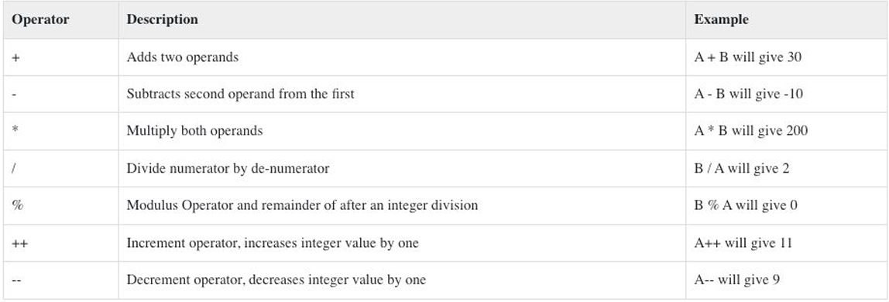
Arithmetic Operators
Let A=10, B=20

Slide 70
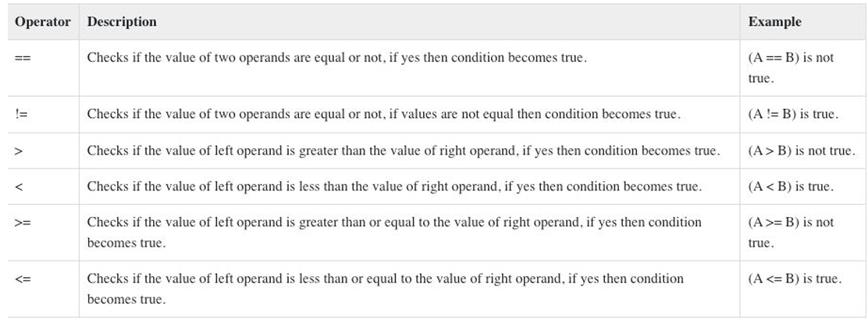
Comparison operators

Slide 71
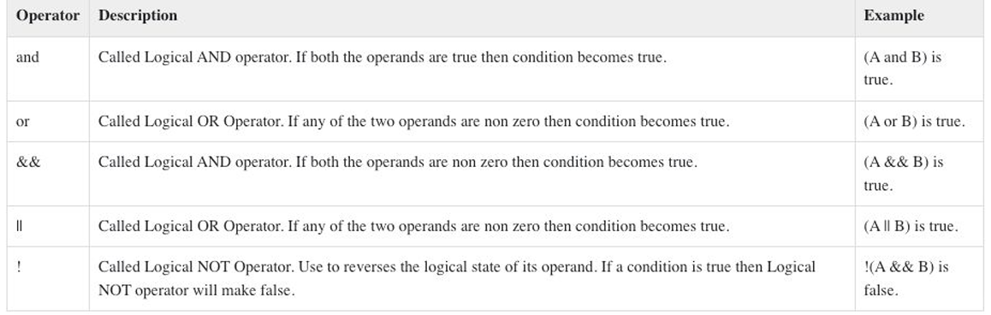
Logical Operators

Slide 72
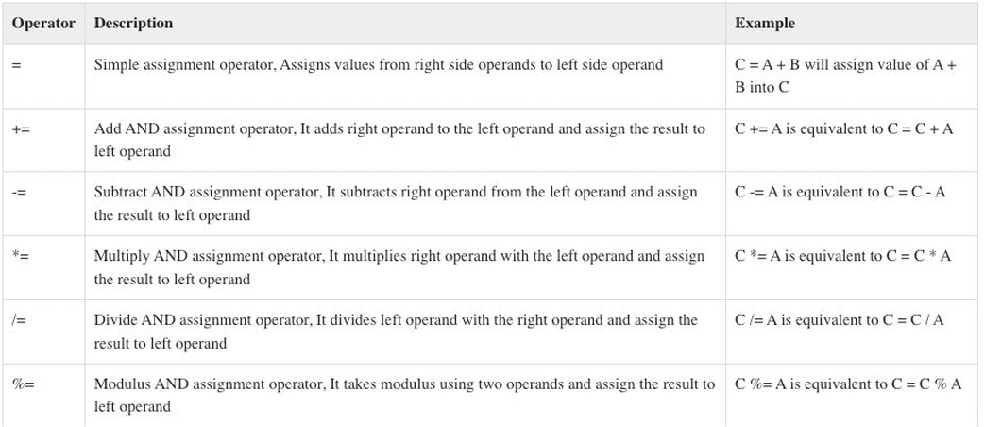
Assignment Operators

Slide 73
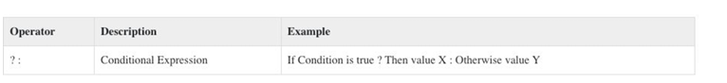
Conditional Operator
<?php
$var=31;
echo ($var%2==0) ? 'The no is even' : 'The no is Odd'
?>

Slide 74
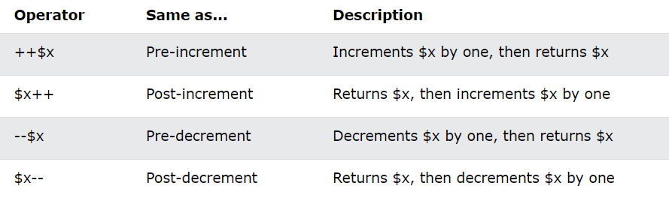
Increment / Decrement Operators

Slide 75
PHP String Operators:
There are two special string operators that help us to operate strings.
Concatenation : (.)
Concatenation Assignment (.= ):

Slide 76
PHP String Operators:
Concatenation (.)
The concatenation operator (.) in PHP is used to combine two strings into one.
<?php
$a = "Hello";
$b = "World";
$c = $a . " " . $b;
echo $c;
?>

Slide 77
PHP String Operators:
Concatenation Assignment (.= ):
The concatenation assignment operator (.=) appends the value on the right to the variable on the left and then assigns the result back to the variable on the left.
<?php
$a = "Hello";
$b = "World";
$a .= " " . $b;
echo $a;
?>

Slide 78
Array Operators:
PHP array operators are used to perform operations on arrays. If $x and $y are array:
Union(+) : $x + $y (Union of $x and $y)
Equality (==): $x == $y (Returns true if $x and $y have the same key/value pairs)
Identity(===): $x === $y (Returns true if $x and $y have the same key/value pairs in the same order and of the same types
Inequality (!= or <> ): $x != $y or $x <> $y (Returns true if $x is not equal to $y)
Non-identity(!==): $x !== $y (Returns true if $x is not identical to $y)

Slide 79
Spaceship Operator:
Spaceship Operator (<=>) is a combined comparison operator which was added in PHP 7.
Integers, floats, and strings can be compared.
‘-1’ if the left operand is less than the right operand,
‘0’ if the operands are equal,
‘1’ if the left operand is greater than the right operand.
So, $a <=> 2 will return
-1 if the value of $a is less than 2,
0 if they are equal, and
1 if $a is greater than 2.

Slide 80
Control Statements
Control statements are statements in programming languages that are used to control the flow of execution of a program.
Types of control statements in PHP:
Conditional Statements
if-else statements, switch-case statements, and ternary operators
Looping Statements
for loops, while loops, and do-while loops.
Jump Statements
break statements, continue statements, and return statements.

Slide 81
Conditional Statements
Conditional statements are used to perform different actions based on different conditions.

Slide 82
If…Else Statement
PHP if else statement is used to test condition.
There are various ways to use if statement in PHP.
if
if-else
if-else-if
nested if

Slide 83
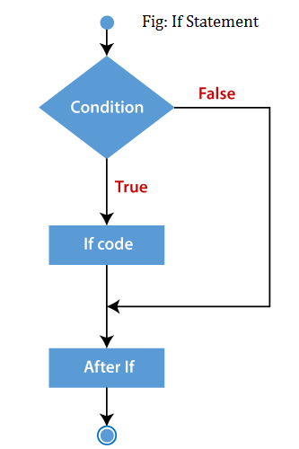
If Statement
It is executed if condition is true.
If statement is used to executes the block of code exist inside the if statement only if the specified condition is true.
Syntax:
if(condition){
//code to be executed
}

Slide 84
If Statement
Example:
$num=12;
if($num<100){
echo "$num is less than 100";
}
Output: 12 is less than 100

Slide 85
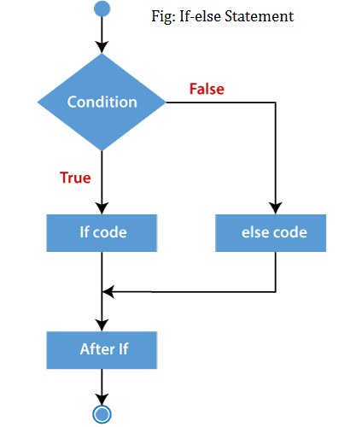
If-else Statement
PHP if-else statement is executed whether condition is true or false.
It executes one block of code if the specified condition is true and another block of code if the condition is false.
Syntax:
if(condition){
//code to be executed if true
}else{
//code to be executed if false
}

Slide 86
If-else Statement
Example:
$num=12;
if($num%2==0){
echo "$num is even number";
}else{
echo "$num is odd number";
}
Output: 12 is even number

Slide 87
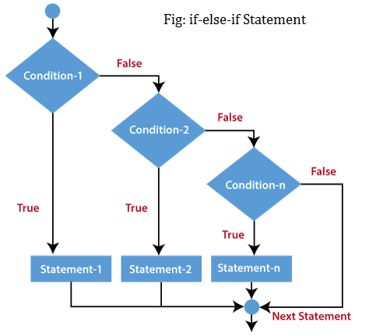
If-else-if Statement
The PHP if-else-if is a special statement used to combine multiple if?.else statements.
So, we can check multiple conditions using this statement.
Syntax:
if (condition1){
//code to be executed if condition1 is true
} elseif (condition2){
//code to be executed if condition2 is true
} elseif (condition3){
//code to be executed if condition3 is true
....
} else{
//code to be executed if all given conditions are false
}

Slide 88
If-else-if Statement
Example: $marks=83; if ($marks<60){ echo "fail"; } else if ($marks>=60 && $marks<75) { echo "D grade"; } else if ($marks>=75 && $marks<80) { echo "C grade"; } | else if ($marks>=80 && $marks<85) { echo "B+ grade"; } else if ($marks>=85 && $marks<90) { echo "A- grade"; } else if ($marks>=90 && $marks<100) { echo "A grade"; } else { echo "Invalid input"; }
Output: B+ Grade

Slide 89
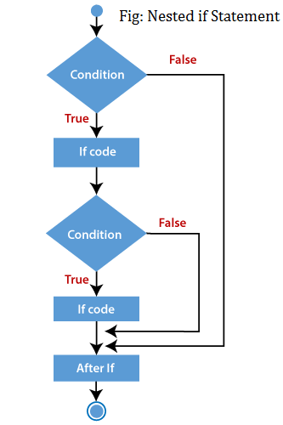
PHP nested if Statement
The nested if statement contains the if block inside another if block.
The inner if statement executes only when specified condition in outer if statement is true.
Syntax:
if (condition) {
//code to be executed if condition is true
if (condition) {
//code to be executed if condition is true
}
}

Slide 90
PHP nested if Statement
Example:
$age = 23;
$nationality = "Nepali";
//applying conditions on nationality and age
if ($nationality == "Nepali")
{
if ($age >= 18) {
echo "Eligible to give vote";
}
else {
echo "Not eligible to give vote";
}
}
Output: Eligible to give vote

Slide 91
Ternary Operator
The ternary operator in PHP is a shorthand way of writing a simple if-else statement.
Syntax:
(condition) ? (value_if_true) : (value_if_false);
Example:
$age = 20;
// Using ternary operator
$status = ($age >= 18) ? "adult" : "minor";
echo $status; // Outputs: adult

Slide 92
Switch Statement
PHP switch statement is used to execute one statement from multiple conditions.
It works like PHP if-else-if statement.
Syntax:
switch (expression) {
case label1:
//code block
break;
case label2:
//code block;
break;
case label3:
//code block
break;
default:
//code block
}
How it works
The expression is evaluated once
The value of the expression is compared with the values of each case
If there is a match, the associated block of code is executed
The break keyword breaks out of the switch block
The default code block is executed if there is no match

Slide 93
Switch Statement
Example:
$favcolor = "red";
switch ($favcolor) {
case "red":
echo "Your favorite color is red!";
break;
case "blue":
echo "Your favorite color is blue!";
break;
case "green":
echo "Your favorite color is green!";
break;
default:
echo "Your favorite color is neither red, blue, nor green!";
}
Output: Your favorite color is red!

Slide 94
PHP Loops
Loops are used to execute the same block of code again and again, as long as a certain condition is true.
Loop Types
while - loops through a block of code as long as the specified condition is true
do...while - loops through a block of code once, and then repeats the loop as long as the specified condition is true
for - loops through a block of code a specified number of times
foreach - loops through a block of code for each element in an array

Slide 95
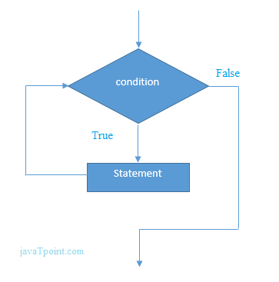
While Loop
The while loop executes a block of code repeatedly until the condition is FALSE. Once the condition gets FALSE, it exits from the body of loop.
It should be used if the number of iterations is not known.
The while loop is also called an Entry control loop because the condition is checked before entering the loop body. This means that first the condition is checked. If the condition is true, the block of code will be executed.
Syntax:
while(condition){
//code to be executed
}

Slide 96
While Loop
Example:
$n=1;
while($n<=10){
echo "$n<br/>";
$n++;
}
Output:
1
2
3
4
5
6
7
8
9
10

Slide 97
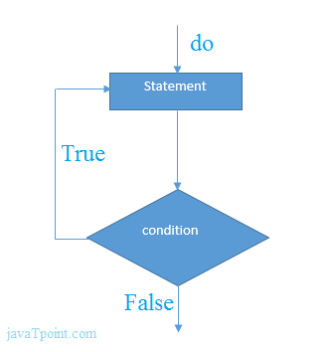
do-while loop
It will always execute the block of code at least once, it will then check the condition, and repeat the loop while the specified condition is true.
If you have to execute the loop at least once and the number of iterations is not even fixed, it is recommended to use the do-while loop.
Syntax:
do{
//code to be executed
}while(condition);

Slide 98
PHP do-while loop
Example:
$n=1;
do{
echo "$n<br/>";
$n++;
}while($n<=10);
Output:
1
2
3
4
5
6
7
8
9
10

Slide 99
Difference between while and do-while loop
while Loop | do-while loop
The while loop is also named as entry control loop. | The do-while loop is also named as exit control loop.
The body of the loop does not execute if the condition is false. | The body of the loop executes at least once, even if the condition is false.
Condition checks first, and then block of statements executes. | Block of statements executes first and then condition checks.
This loop does not use a semicolon to terminate the loop. | Do-while loop use semicolon to terminate the loop.

Slide 100
for Loop
The for loop is used when you know how many times the script should run.
Syntax:
for(initialization; condition; increment/decrement){
//code to be executed
}
Example:
for ($x = 0; $x <= 10; $x++) {
echo "The number is: $x <br>";
}
Output:
The number is: 0 The number is: 1 The number is: 2 The number is: 3 The number is: 4 The number is: 5 The number is: 6 The number is: 7 The number is: 8 The number is: 9 The number is: 10

Slide 101
foreach Loop
Foreach is used to loop through the items of an array..
It works only on array and object.
The foreach loop works on elements basis rather than index.
we don't need to increment the value.
Syntax:
foreach ($array as $value) {
//code to be executed
}

Slide 102
foreach Loop
Example:
$colors = array("red", "green", "blue", "yellow");
foreach ($colors as $x) {
echo "$x <br>";
}
Output:
red green blue yellow

Slide 103
Break Statement
It breaks the current flow of the program at the specified condition and program control resumes at the next statements outside the loop.
The break statement can be used in all types of loops such as while, do-while, for, foreach loop, and also with switch case.
Syntax:
while(expr){
if (condition){
break;
}
}

Slide 104
Break Statement
for ($x = 0; $x < 10; $x++) {
if ($x == 4) {
break;
}
echo "The number is: $x <br>";
}
Output:
The number is: 0
The number is: 1
The number is: 2
The number is: 3

Slide 105
Continue Statement
It allows the user to skip the execution of the code for the specified condition.
The continue statement can be used with all types of loops such as - for, while, do-while, and foreach loop. Syntax:
Syntax:
while(expr){
if (condition){
continue;
}
}

Slide 106
Continue Statement
Example:
for ($x = 0; $x < 10; $x++) {
if ($x == 4) {
continue;
}
echo "The number is: $x <br>";
}
Output:
The number is: 0 The number is: 1 The number is: 2 The number is: 3 The number is: 5 The number is: 6 The number is: 7 The number is: 8 The number is: 9

Slide 107
Questions
Write a PHP script to check if a given number is positive, negative, or zero using an if statement.
Write a PHP script to find the largest of three numbers using nested if statements.
Write a PHP script to print the name of the day based on the number (1-7) using a switch statement.
Write a PHP script to print the first 10 natural numbers using a for loop.
Write a PHP script to iterate through an associative array and print the key-value pairs using a foreach loop.

Slide 108
Questions
Write a PHP script to print numbers from 1 to 5 using a while loop
Write a PHP script to print numbers from 1 to 5 using a do-while loop.
Write a PHP script to print numbers from 1 to 10, but break the loop when the number is 5.
Write a PHP script to print numbers from 1 to 10, but skip the number 5.
Rewrite the following if-else statement using the ternary operator.
if ($age >= 18) {
$status = "adult";
} else {
$status = "minor";
}

Slide 109
PHP Functions
functions are blocks of code designed to perform specific tasks.
It can take input as argument list and return value.
In PHP, we can define Conditional function, Function within Function and Recursive function also.
Types of Functions
Built-in functions
User Defined Functions

Slide 110
Types of Functions
Built-in functions :
PHP provides us with huge collection of built-in library functions.
These functions are already coded and stored in form of functions.
To use those we just need to call them as per our requirement like, var_dump, fopen(), print_r(), gettype() and so on.
User Defined Functions :
Apart from the built-in functions, PHP allows us to create our own customised functions called the user-defined functions.
Using this we can create our own packages of code and use it wherever necessary by simply calling it.

Slide 111
Advantage of PHP Functions
Code Reusability: PHP functions are defined only once and can be invoked many times, like in other programming languages.
Less Code: It saves a lot of code because you don't need to write the logic many times. By the use of function, you can write the logic only once and reuse it.
Easy to understand: PHP functions separate the programming logic. So it is easier to understand the flow of the application because every logic is divided in the form of functions.

Slide 112
Creating a Function
Any name ending with an open and closed parenthesis is a function.
A function name always begins with the keyword function.
To call a function, we just need to write its name followed by the parenthesis
A function name cannot start with a number.
It can start with an alphabet or underscore.
A function name is not case-sensitive.
Syntax:
function function_name(){
//code to be executed
}

Slide 113
Example
function sayHello(){
echo "Hello PHP Function";
}
sayHello();//calling function
Output: Hello PHP Function

Slide 114
Function Parameters or Arguments
The information or variable, within the function’s parenthesis, are called parameters.
These are used to hold the values executable during runtime.
A user is free to take in as many parameters as he wants, separated with a comma(,) operator.
These parameters are used to accept inputs during runtime.
While passing the values like during a function call, they are called arguments.
An argument is a value passed to a function and a parameter is used to hold those arguments.
In common term, both parameter and argument mean the same.
We need to keep in mind that for every parameter, we need to pass its corresponding argument.
Syntax:
function function_name($first_parameter, $second_parameter) {
// executable code;
}

Slide 115
Example:
function sayHello($name,$age){
echo "Hello $name, you are $age years old<br/>";
}
sayHello("Sonoo",27);
sayHello("Vimal",29);
sayHello("John",23);
Output:
Hello Sonoo, you are 27 years old
Hello Vimal, you are 29 years old
Hello John, you are 23 years old

Slide 116
Default Values for Function parameter
PHP allows us to set default argument values for function parameters.
If we do not pass any argument for a parameter with default value then PHP will use the default set value for this parameter in the function call.
Example:
function greet($name = "World") {
echo "Hello, $name!";
}
greet(); // Outputs: Hello, World!
greet("Bob"); // Outputs: Hello, Bob!

Slide 117
Returning Values from Functions
Functions can also return values to the part of program from where it is called.
The return keyword is used to return value back to the part of program, from where it was called.
The returning value may be of any type including the arrays and objects.
Once return is executed, the function stops and the specified value is returned to the caller.
Example:
function add($a, $b) {
return $a + $b;
}
$result = add(2, 3);
echo $result; // Outputs: 5

Slide 118
Returning Multiple Values
PHP does not support returning multiple values directly, but you can return an array containing multiple values.
Example:
function divide($a, $b) {
$quotient = $a / $b;
$remainder = $a % $b;
return array($quotient, $remainder);
}
list($quotient, $remainder) = divide(10, 3);
echo "Quotient: $quotient, Remainder: $remainder";
// Outputs: Quotient: 3.3333333333333, Remainder: 1

Slide 119
Parameter passing to Functions
PHP allows us two ways in which an argument can be passed into a function:
Pass by Value:
On passing arguments using pass by value, the value of the argument gets changed within a function, but the original value outside the function remains unchanged.
That means a duplicate of the original value is passed as an argument.
Pass by Reference:
On passing arguments as pass by reference, the original value is passed. Therefore, the original value gets altered.
In pass by reference, we actually pass the address of the value, where it is stored using ampersand sign(&).

Slide 120
Parameter passing to Functions: Example
// pass by value function valGeek($num) { $num += 2; return $num; } // pass by reference function refGeek(&$num) { $num += 10; return $num; } | $n = 10; valGeek($n); echo "The original value is still $n \n"; refGeek($n); echo "The original value changes to $n";
Output:
The original value is still 10
The original value changes to 20

Slide 121
Variable Length Argument Function
By using the ... operator in front of the function parameter, the function accepts an unknown number of arguments. This is also called a variadic function.
The variadic function argument becomes an array.
Example: function sum(...$numbers) {
$sum = 0;
foreach ($numbers as $n) {
$sum += $n;
}
return $sum;
}
echo sum(1, 2, 3, 4); // Outputs: 10
echo sum(1, 2, 3, 4, 5); // Outputs: 15

Slide 122
The variadic argument must be the last argument:
function myFamily($lastname, ...$firstname) {
$txt = "";
$len = count($firstname);
for($i = 0; $i < $len; $i++) {
$txt = $txt."Hi, $firstname[$i] $lastname.<br>";
}
return $txt;
}
$a = myFamily("Doe", "Jane", "John", "Joey");
echo $a;
Output:
Hi, Jane Doe.
Hi, John Doe.
Hi, Joey Doe.

Slide 123
Anonymous Functions (Closures)
An anonymous function is a function that doesn’t have any name specified at the time of definition.
Such a function is also called closure or lambda function.
Sometimes, you may want a function for one time use only. The most common use of anonymous functions is to create an inline callback function.
There is no function name between the function keyword and the opening parenthesis, and the fact that there is a semicolon after the function definition.
Anonymous function can be called later using the variable’s name
Syntax:
$var=function ($arg1, $arg2) { return $val; };
Notes:
Note that there is no function name between the function keyword and the opening parenthesis, and the fact that there is a semicolon after the function definition.
This implies that anonymous function definitions are expressions.
When assigned to a variable, the anonymous function can be called later using the variable’s name.
Anonymous functions are implemented using the Closure class. Closure is an anonymous function that closes over the environment in which it is defined.

Slide 124
Example
$greet = function($name) {
echo "Hello, $name!";
};
$greet("Tika Ram"); // Outputs: Hello, Tika Ram!

Slide 125
Recursive Function
A recursive function is a function that calls itself in order to solve a problem.
It is also known as recursion.
It is recommended to avoid recursive function call over 200 recursion level because it may smash the stack and may cause the termination of script.
Example:
function display($number) {
if($number<=5){
echo "$number <br/>";
display($number+1);
}
}
display(1);
Output:
1 2 3 4 5

Slide 126
Factorial Example
The factorial of a non-negative integer n is the product of all positive integers less than or equal to n. It's denoted as n! and defined as:
0! = 1
n! = n×(n−1)! for n > 0
Notes:
Explanation
Base Case:
The function checks if n is 0 or 1.
If true, it returns 1 because the factorial of 0 and 1 is 1.
Recursive Case:
If n is greater than 1, the function returns n × factorial (n−1).
This calls the factorial function again with n−1.

Slide 127
Factorial Example
function factorial($n) {
// Base case: if $n is 0, return 1
if ($n == 0) {
return 1;
} else {
// Recursive case: $n * factorial($n - 1)
return $n * factorial($n - 1);
}
}
// Example usage:
$number = 5;
echo "Factorial of $number is " . factorial($number);
Outpur: Factorial of 5 is 120

Slide 128
Fibonacci Example
The Fibonacci sequence is another classic example, where each number in the sequence is the sum of the two preceding ones, usually starting with 0 and 1.
The Fibonacci sequence is defined as:
F(0) = 0
F(1) = 1
F(n) = F(n−1)+F(n−2) for n > 1

Slide 129
Fibonacci Example
function fibonacci($n) {
// Base cases: if $n is 0 or 1, return $n
if ($n == 0) {
return 0;
} else if ($n == 1) {
return 1;
} else {
// Recursive case: fibonacci($n - 1) + fibonacci($n - 2)
return fibonacci($n - 1) + fibonacci($n - 2);
}
}
// Example usage:
$number = 7;
echo "Fibonacci of $number is " . fibonacci($number);
// output: Fibonacci of 7 is 13

Slide 130
Fibonacci Example
function fibonacci($n) { if ($n == 0) { return 0; } else if ($n == 1) { return 1; } else { return fibonacci($n - 1) + fibonacci($n - 2); } } | function displayFibonacciSeries($count) { for ($i = 0; $i < $count; $i++) { echo fibonacci($i) . " "; } } // Example: Display first 10 Fibonacci numbers $count = 10; echo "Fibonacci series of $count numbers: "; displayFibonacciSeries($count);
Output: Fibonacci series of 10 numbers: 0 1 1 2 3 5 8 13 21 34

Slide 131
Question
Q. Create a function called 'calculate' which calculates area, perimeter & volume of a rectangle. Make your own assumptions for the parameters. So, while calling the function as calculate(10,20, 'area') it should return an output as “The area of a rectangle is: 200” and so on for the rest.

Slide 132
Answer
function calculate($l, $b, $act = "area", $h = 0)
{
if ($act == "area") {
echo "The area of rectangle is: " . ($l * $b);
} else if ($act == "perimeter") {
echo "The perimeter of rectangle is: " . (2 * ($l + $b));
} else if ($act == "volume" && $h != 0) {
echo "The volume of rectangle is: " . ($l * $b * $h);
} else {
echo "Your credentials did not match.";
}
}
calculate(10, 20, 'area');

Slide 133
Question
Q. WAP to calculate the number palindrome using user defined function.
<?php function palindrome($num) { $temp = $num; $rev = 0; while ($num > 0) { $rem = $num % 10; $rev = $rev * 10 + $rem; $num = (int)($num / 10); } | if ($temp == $rev) { echo "The number is palindrome"; } else { echo "The number is not palindrome"; } } $num = 121; palindrome($num); ?>

Slide 134
Including and Requiring Files
In the realms of computer science and software engineering, reusability and modularity are considered to be important design principles to keep in mind when building software programs.
The key idea behind these principles is to write code in a way that does not concentrate all it’s operations in one place.
It is therefore advocated to break down your code into several smaller, atomic parts that are independent, reusable and replaceable.
This makes projects easier to debug, reduces redundancy, saves an awful lot of memory and resources, and allows for localized, thus more stable updates.

Slide 135
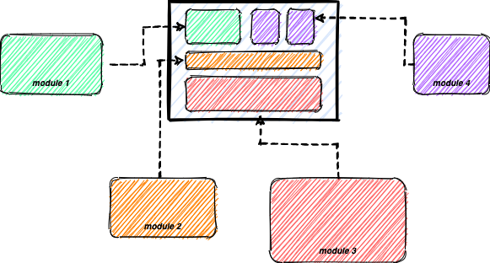
Notes:
A very common example of this can be seen in any website you visit on the internet.
Most websites share a very common abstract structure - each webpage has a navigation bar (or header), a footer, and some content between the two.
It is a common practice of web developers to reuse components like the header, footer, and many others across all the pages of the website.
This can be implemented by defining these components once and using (importing/including) them anywhere and everywhere we like.
The virtues of reusability and modularity are not just restricted to web components - we can just as effectively compartmentalize and reuse external classes, functions, and variables.

Slide 136
Including and Requiring Files
It is possible to insert the content of one PHP file into another PHP file (before the server executes it), with the include or require statement.
Both include and require are identical to each other, except failure.
include only generates a warning, i.e., E_WARNING, and continue the execution of the script.
require generates a fatal error, i.e., E_COMPILE_ERROR, and stop the execution of the script.
Notes:
if you want the execution to go on and show users the output, even if the include file is missing, use the include statement.
Otherwise, in case of FrameWork, CMS, or a complex PHP application coding, always use the require statement to include a key file to the flow of execution.
This will help avoid compromising your application's security and integrity, just in-case one key file is accidentally missing.
Including files saves a lot of work.
This means that you can create a standard header, footer, or menu file for all your web pages.
Then, when the header needs to be updated, you can only update the header include file.

Slide 137
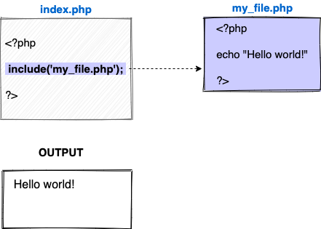
Including and Requiring Files

Slide 138
Advantage
Code Reusability:
By the help of include and require construct, we can reuse HTML code or PHP script in many PHP scripts.
Easy editable:
If we want to change anything in webpages, edit the source file included in all webpage rather than editing in all the files separately.

Slide 139
Including and Requiring Files
PHP provides four functions to include and require files within your scripts:
include,
require,
include_once, and
require_once.
These functions are used to incorporate the contents of one PHP file into another, which is useful for modularizing your code.

Slide 140
include
The include function inserts the specified file at the point where it is called.
If the file is not found, PHP emits a warning but the script continues to execute.
Example:
<?php
include 'header.php’; // Includes the content of header.php
echo "Main content of the page.";
?>

Slide 141
Advantages of Include in php
Code Reusability :
By using the include statement, you can include and reuse code snippets, functions, or entire scripts across multiple PHP files or projects.
This promotes code reusability and reduces code duplication, saving development time and effort.
Modular Development :
With the ability to include external files, PHP code can be organized into separate files based on functionality or purpose.
This promotes a modular development approach, making code more manageable, maintainable, and easier to understand.

Slide 142
Advantages of Include in php
Separation of Concerns :
The included statement enables the separation of concerns, allowing you to divide code into different files based on their specific responsibilities.
This improves code organization, readability, and overall code quality.
Easy Updates and Maintenance :
When changes or updates are required, modifying a single included file automatically applies the changes across all the files where it is included.
This simplifies updates and maintenance, as you only need to modify and test one file instead of searching for and updating code in multiple locations.

Slide 143
Advantages of Include in php
Code Organization :
Including files through the include statement helps in structuring code in a more organized manner.
Related code can be grouped in separate files, making it easier to navigate, understand, and maintain the codebase.
Dynamic File Inclusion :
The include statement supports dynamic file inclusion by using variables as part of the file name.
This allows you to include files based on conditions or user input, providing dynamic control over the inclusion process.

Slide 144
require
The require function is similar to include, but if the file is not found, PHP emits a fatal error and stops the script execution.
Example:
<?php
require 'config.php’; // Includes the content of config.php
echo "Main content of the page.";
?>

Slide 145
include_once
The include_once function works like include, but it ensures that the specified file is included only once during the execution of the script.
This prevents multiple inclusions of the same file.
Example:
<?php
include_once 'functions.php’; // Includes functions.php only once
include_once 'functions.php’; // This inclusion will be ignored
?>

Slide 146
require_once
The require_once function works like require, but it ensures that the specified file is included only once during the execution of the script.
Example:
<?php
require_once 'settings.php’; // Includes settings.php only once
require_once 'settings.php’; // This inclusion will be ignored
?>

Slide 147
Difference between require() and include() Functions:
include() | require()
The include() function does not stop the execution of the script even if any error occurs. | The require() function will stop the execution of the script when an error occurs.
The include() function does not give a fatal error. | The require() function gives a fatal error
The include() function is mostly used when the file is not required and the application should continue to execute its process when the file is not found. | The require() function is mostly used when the file is mandatory for the application.
The include() function will only produce a warning (E_WARNING) and the script will continue to execute. | The require() will produce a fatal error (E_COMPILE_ERROR) along with the warning and the script will stop its execution.
The include() function generate various functions and elements that are reused across many pages taking a longer time for the process completion. | The require() function is more in recommendation and considered better whenever we need to stop the execution incase of availability of file, it also saves time avoiding unnecessary inclusions and generations.

Slide 148
Variables Scope
The scope of a variable is the portion of the program within which it is defined and can be accessed.
Variables can be declared anywhere in the script.
PHP has three types of variable scopes:
Local variable
Global variable
Static variable

Slide 149
Local variable
The variables that are declared within a function are called local variables for that function.
These local variables have their scope only in that particular function in which they are declared.
This means that these variables cannot be accessed outside the function, as they have local scope.
A variable declaration outside the function with the same name is completely different from the variable declared inside the function.

Slide 150
Local variable
Example:
function myFunction() {
$localVar = "I'm a local variable";
echo $localVar; // This will work
}
myFunction();
echo $localVar; // This will not work, as $localVar is undefined outside the function
Output:
I'm a local variable Warning: Undefined variable $localVar in C:\xampp\htdocs\BIM\07_function\02_variable_scope.php on line 13

Slide 151
Global variable
The global variables are the variables that are declared outside the function.
These variables can be accessed anywhere in the program.
To access the global variable within a function, use the GLOBAL keyword before the variable.
However, these variables can be directly accessed or used outside the function without any keyword.
Therefore there is no need to use any keyword to access a global variable outside the function.

Slide 152
Global variable
Example 1:
$globalVar = "I'm a global variable";
function myFunction2() {
echo $globalVar; // This will not work
}
myFunction2();
echo $globalVar; // This will work
Output:
Warning: Undefined variable $globalVar in C:\xampp\htdocs\BIM\07_function\02_variable_scope.php on line 25 I'm a global variable

Slide 153
Global variable
Example 2:
$globalVar = "I'm a global variable";
function myFunction2() {
global $globalVar;
echo $globalVar; // This will work
}
myFunction2();
echo $globalVar; // This will work
Output:
I'm a global variable I'm a global variable

Slide 154
Static variable
It is a feature of PHP to delete the variable, once it completes its execution and memory is freed.
Sometimes we need to store a variable even after completion of function execution.
Therefore, another important feature of variable scoping is static variable.
We use the static keyword before the variable to define a variable, and this variable is called as static variable.
Static variables exist only in a local function, but it does not free its memory after the program execution leaves the scope.

Slide 155
Static variable
Example:
function static_var()
{
static $num1 = 3;
$num2 = 6;
$num1++;
$num2++;
echo "Static variable is: $num1, ";
echo "Local variable is: $num2\n";
}
static_var();
static_var();
Output:
Static variable is: 4,
Local variable is: 7
Static variable is: 5,
Local variable is: 7

Slide 156
PHP Superglobals
In PHP, superglobal variables are special variables that are predefined and accessible from anywhere within a PHP script.
They hold information about the server, client, and environment, allowing developers to access and manipulate important data without having to explicitly pass them as parameters or retrieve them from external sources.
Superglobals are available in all scopes of a PHP script, including functions, classes, and global scope.
Notes:
Reference:
https://www.scaler.com/topics/super-global-variable-in-php/
https://www.geeksforgeeks.org/php-superglobals/
For second sentence:
These hold information about the server, client, and environment, letting developers access and use important data easily.
This means they don't need to manually pass this data around or fetch it from other places.

Slide 157
PHP Superglobals
Superglobal variables are denoted with a leading underscore followed by uppercase letters, such as $_SERVER, $_GET, $_POST, $_SESSION, and more.
Each superglobal variable serves a specific purpose and provides different types of information.
For example,
$_SERVER contains information about the server and execution environment, including request headers, server details, and paths.
$_GET and $_POST store data submitted through HTTP GET and POST methods, respectively.
Notes:
Superglobal variables are useful in various scenarios, such as accessing form data, managing user sessions, retrieving server information, handling cookies, and more.
However, it is important to handle superglobal variables with caution, as they directly expose data from external sources.
Proper input validation, sanitization, and security measures should be implemented to prevent potential security vulnerabilities, such as SQL injection and cross-site scripting (XSS) attacks.

Slide 158
The PHP superglobal variables are:
$GLOBALS
$_SERVER
$_GET
$_POST
$_FILES
$_COOKIE
$_SESSION
$_REQUEST
$_ENV

Slide 159
$GLOBALS
It is a superglobal variable which is used to access global variables from anywhere in the PHP script.
PHP stores all the global variables in array $GLOBALS[] where index holds the global variable name, which can be accessed.
Example:
<?php
$x = 300;
$y = 200;
function multiplication(){
$GLOBALS['z'] = $GLOBALS['x'] * $GLOBALS['y'];
}
multiplication();
echo $z;
?>
Output: 60000
Notes:
In the above code two global variables are declared $x and $y which are assigned some value to them. Then a function multiplication() is defined to multiply the values of $x and $y and store in another variable $z defined in the GLOBAL array.

Slide 160
$_SERVER
It is a PHP super global variable that stores the information about headers, paths and script locations.
Some of these elements are used to get the information from the superglobal variable $_SERVER.
Example:
<?php
echo $_SERVER['PHP_SELF'];
echo "<br>";
echo $_SERVER['SERVER_NAME'];
echo "<br>";
echo $_SERVER['HTTP_HOST'];
echo "<br>";
echo $_SERVER['HTTP_USER_AGENT'];
echo "<br>";
echo $_SERVER['SCRIPT_NAME'];
echo "<br>"
?>
Output:
/BIM_TRK/08_super_global/02_$_SERVER.php localhost localhost Mozilla/5.0 (Windows NT 10.0; Win64; x64) AppleWebKit/
537.36 (KHTML, like Gecko) Chrome/126.0.0.0 Safari/537.36 /BIM_TRK/08_super_global/02_$_SERVER.php
Notes:
In the above code we used the $_SERVER elements to get some information.
We get the current file name which is worked on using ‘PHP_SELF’ element.
Then we get server name used currently using ‘SERVER_NAME’ element. And then we get the host name through ‘HTTP_HOST’.

Slide 161
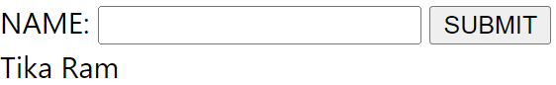
$_REQUEST
It is a superglobal variable which is used to collect the data after submitting a HTML form.
$_REQUEST is not used mostly, because $_POST and $_GET perform the same task and are widely used.
Example:
<form method="post" action="<?php echo $_SERVER['PHP_SELF'];?>"> NAME: <input type="text" name="fname"> <button type="submit">SUBMIT</button> </form> | <?php if ($_SERVER["REQUEST_METHOD"] == "POST") { $name = htmlspecialchars($_REQUEST['fname']); if(empty($name)){ echo "Name is empty"; } else { echo $name; } } ?>
Output:
Notes:
In the above code we have created a form that takes the name as input from the user and prints it’s name on clicking of submit button.
We transport the data accepted in the form to the same page using $_SERVER[‘PHP_SELF’] element as specified in the action attribute, because we manipulate the data in the same page using the PHP code.
The data is retrieved using the $_REQUEST superglobal array variable

Slide 162
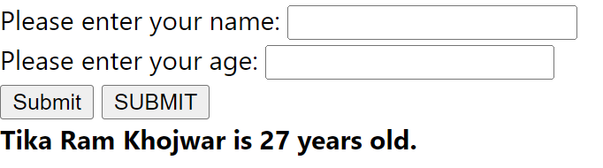
$_POST
It is a super global variable used to collect data from the HTML form after submitting it.
When form uses method post to transfer data, the data is not visible in the query string, because of which security levels are maintained in this method.
Example:
<form method="post" action="<?php echo $_SERVER['PHP_SELF'];?>"> <label for="name">Please enter your name: </label> <input name="name" type="text"><br> <label for="age">Please enter your age: </label> <input name="age" type="text"><br> <input type="submit" value="Submit"> <button type="submit">SUBMIT</button> </form> | <?php $nm=$_POST['name']; $age=$_POST['age']; echo "<strong>". $nm ." is $age years old.</strong>"; ?>
Output
Notes:
In the above code we have created a form that takes name and age of the user and accesses the data using $_POST super global variable when they submit the data.
Since each superglobal variable is an array it can store more than one values.
Hence we retrieved name and age from the $_POST variable and stored them in $nm and $age variables.

Slide 163
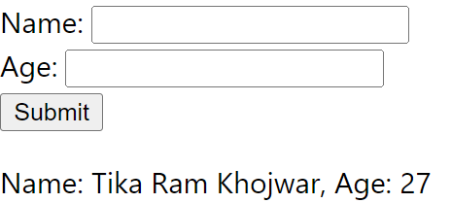
$_GET
$_GET is a super global variable used to collect data from the HTML form after submitting it.
When form uses method get to transfer data, the data is visible in the query string, therefore the values are not hidden.
$_GET super global array variable stores the values that come in the URL.
Example:
<form method="GET" action=""> <label for="name">Name:</label> <input type="text" id="name" name="name" required> <br> <label for="age">Age:</label> <input type="number" id="age" name="age" required> <br> <input type="submit" value="Submit"> </form> | <?php if (isset($_GET['name']) && isset($_GET['age'])) { $name = htmlspecialchars($_GET['name']); // "John" $age = htmlspecialchars($_GET['age']); // "25" echo "<p>Name: $name, Age: $age</p>"; } ?>
Output

Slide 164
$_FILES
It is an associative array that provides information about uploaded files in an HTTP POST request.
It contains details such as file name, file type, temporary file location, etc.
Example:

Slide 165
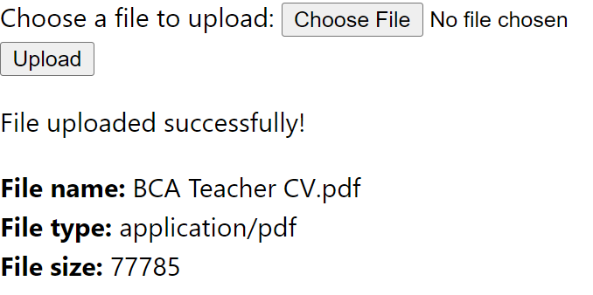
<form method="POST" action="" enctype="multipart/form-data"> <label for="userfile">Choose a file to upload:</label> <input type="file" id="userfile" name="userfile" required> <br> <input type="submit" value="Upload"> </form> | <?php if ($_SERVER['REQUEST_METHOD'] == 'POST' && isset($_FILES['userfile'])) { $fileName = $_FILES['userfile']['name']; $fileTmpName = $_FILES['userfile']['tmp_name']; // Ensure the uploads directory exists if (!is_dir('uploads')) { mkdir('uploads', 0755, true); } if (move_uploaded_file($fileTmpName, "uploads/$fileName")) { echo "<p>File uploaded successfully!</p>"; echo "<b> File name: </b>" . $_FILES['userfile']['name'] . "</br>"; echo "<b> File type: </b>" . $_FILES['userfile']['type'] . "</br>"; echo "<b> File size: </b>" . $_FILES['userfile']['size'] . "</br>"; } else { echo "<p>File upload failed. Please try again.</p>"; } } ?>
Output:

Slide 166
$_COOKIE
It is an associative array that holds the values of cookies sent by the client to the server.
Cookies are used to store small amounts of data on the client side.
Example
<?php
// Set first cookies
$cookieName = "user";
$cookieValue = "Tika Ram";
setcookie($cookieName, $cookieValue, time() + (86400 * 30), "/"); // Set cookie for 30 days
if(isset($_COOKIE[$cookieName])) {
echo "<p>Cookie value: " . htmlspecialchars($_COOKIE[$cookieName]) . "</p>";
} else {
echo "<p>Cookie is not set yet.</p>";
}
?>
Output: Cookie value: Tika Ram

Slide 167
$_SESSION
It is an associative array that stores and retrieves session-specific data across multiple requests.
It allows you to persist data between different pages or interactions with a user.
Example:
<?php
// Start the session
session_start();
// Set session variable
$_SESSION['username'] = "Tika Ram";
// Display the session variable
echo "<p>Session username: " . htmlspecialchars($_SESSION['username']) . "</p>";
?>
Output: Session username: Tika Ram

Slide 168
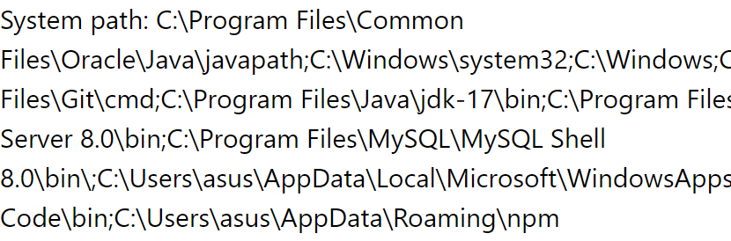
$_ENV
It is an associative array that provides access to the environment variables set on the server.
Environment variables contain system-specific information
such as the server's operating system, paths, and configuration settings.
Example:
<?php
$path = $_ENV['PATH'];
echo "System path: $path";
// OR
$path = getenv('PATH');
echo "System path: $path";
?>
Output:

Slide 169
Thank You!!!

Slide 170
Questions
Q1. WAP to calculate Factorial without using recursive function.
Q2. WAP to calculate Factorial using recursive function.
Q3. WAP to calculate Fibonacci series using user defined function.
Q4. WAP to calculate Fibonacci series using recursive function.
Q5. WAP to calculate the number palindrome using user defined function.
Q6. Create a function called 'calculate' which calculates area, perimeter & volume of a rectangle. Make your own assumptions for the parameters. So, while calling the function as calculate(10,20, 'area') it should return an output as “The area of a rectangle is: 200” and so on for the rest.

